Slide 1


A Project On
EatIt : Online Food Ordering & Delivery App
Department of Computer Science & Information Technology
GURU GHASIDAS VISHWAVIDYALAYA, BILASPUR (C.G.)
SESSION 2019-20
Submitted to:
Mrs. P. Pujari
HOD Department of CSIT
Mr. Suman Laha
Asst. Prof. Department of CSIT
Submitted by:
Devesh Sahu
MCA V Sem

Slide 2
Objective
The purpose of online food ordering applications is to automate the existing physical structure by the help of automated apparatus and full-fledged Mobile Application, satisfying their requirements, so that their appreciated data/information can be deposited for a longer stage with easy retrieving and guidance of the identical.
This investigation work goals to automate the food ordering process in near neighborhood and also improve the dining understanding of customers.
This system, implements wireless data entrance to server.
The android application on user’s mobile will have all the menu specifics.
The order details from customer’s mobile are wirelessly rationalized in central database and consequently send to kitchen and cashier correspondingly.

Slide 3
Introduction
The “EatIt : Food Ordering Android Application” has been residential to countermand the problems customary in the practicing handbook system.
A location-based service (LBS) is a mobile application that is dependent on the location of a mobile device, like mobile phone.
Moreover this system is designed for exacting need of the company to carry out operations in a smooth and effective manner.
The Food Ordering Android Application is the Android Application for customized Food ordering. User will be capable to get delivery on his present location by GPS description.
Delivery tracking, food production process suggestion, share enduring food, plunder and many more description are there in Food Ordering Android Application.
The application is condensed as much as potential to avoid errors while incoming the data. It also provides error message while incoming unsound data.
No formal facts is needed for the user to use this system. Thus by this all it provides it is intelligible. Food Ordering Android Application, as described above, can lead to mistake free, protected, reliable and fast administration system.
It can help the user to deliberate on their other performance rather to deliberate on the record maintenance.

Slide 4
Software & Hardware Requirement
Software Requirement:
WINDOWS OS( xp and above), Linux, Mac OS.
Any Browser for accessing Firebase & some Google and other APIs.
Android Studio Latest Version with latest SDK tools.
SQLite DB Browser.
ARC tool & AVD(android virtual device) for testing.
HARDWARE REQUIREMENT:
1.8 GHz Processors and above
RAM 4 GB and above
HDD 40 GB hard disk space and above
An Android Smartphone with Android OS lollipop or higher.

Slide 5
Data Flow Diagram
Client App: First Screen of app
Welcome Activity
Sign Up
Sign In
Add data to firebase database
Verify the data and login
Home Activity

Slide 6
Home Activity
Cart Activity
Home Activity:
Cart Activity:
Click Menu Item or Banner Item
Place order
Order Dialog box
Sub-category activity
Payment Gateway & processing order
Add to cart or give review or comment
Comment Activity
Cart Activity
Home Activity

Slide 7
Server App:
Welcome Activity:
Add, Modify & Delete:
Home Activity
Welcome Activity
Click Items
Verify the data and login
Category Activity
Sub-category Activity
Banner Activity
Database
Add Modify & Delete in firebase database
Database
Home Activity
Current Activity

Slide 8
Order Management:
Order Activity
Click Items
Status
Remove
Details
Direction
Database
Current Activity

Slide 9
Modules
Server or Admin App
Login
Edit Category
Add Category
Delete Category
Edit Banner Item
Add Banner Item
Delete Banner Item
Edit Food Item
Add Food Item
Delete Food Item
Order Modification
Edit Order Status
Remove Order Status
Details
Direction
Client App
Register
Login
Order Food
Update Home Address
Change orders
Modify order before order placed

Slide 10
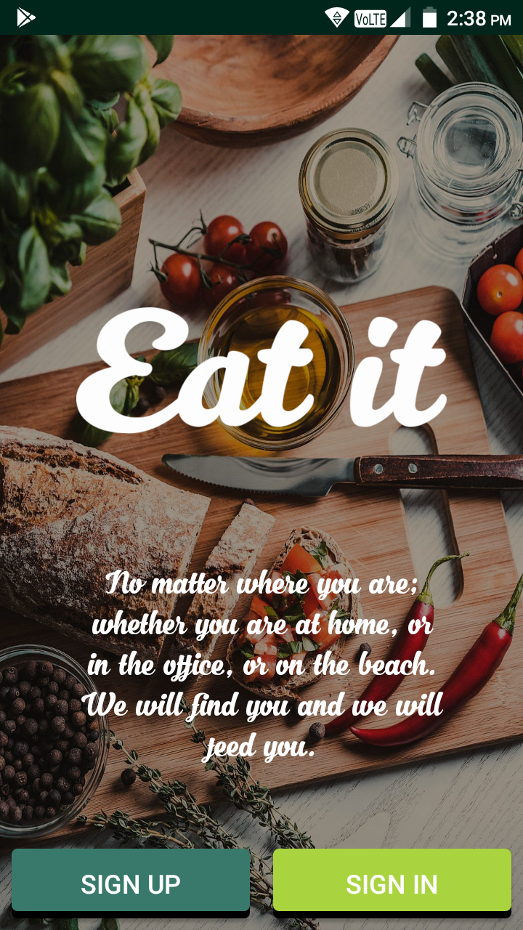
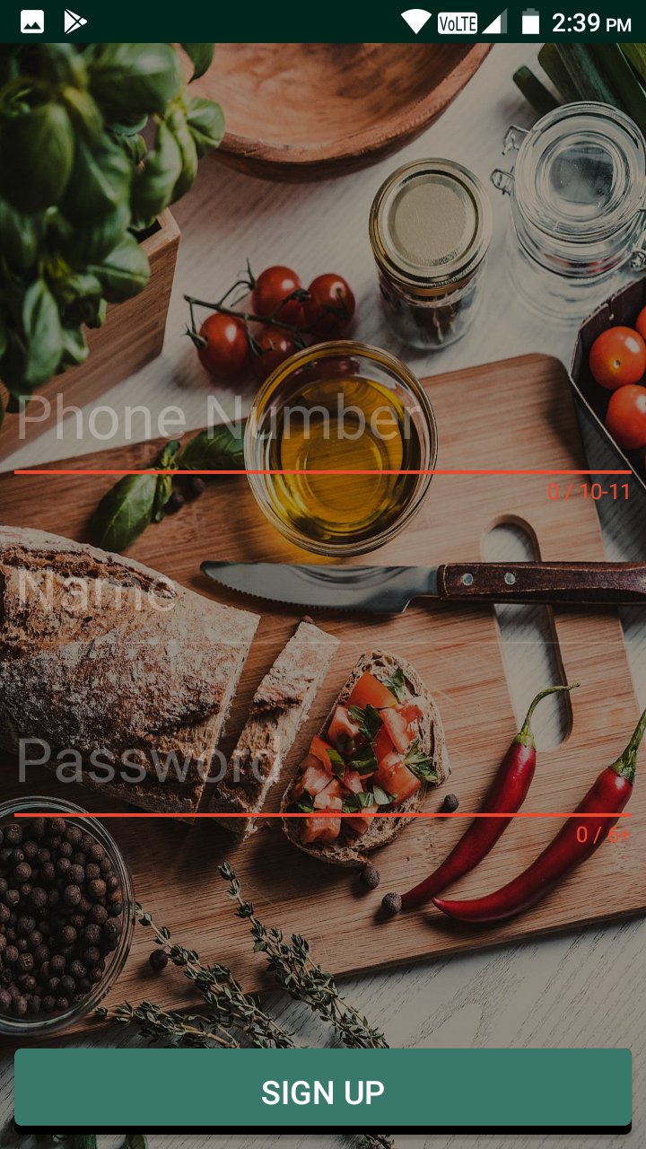
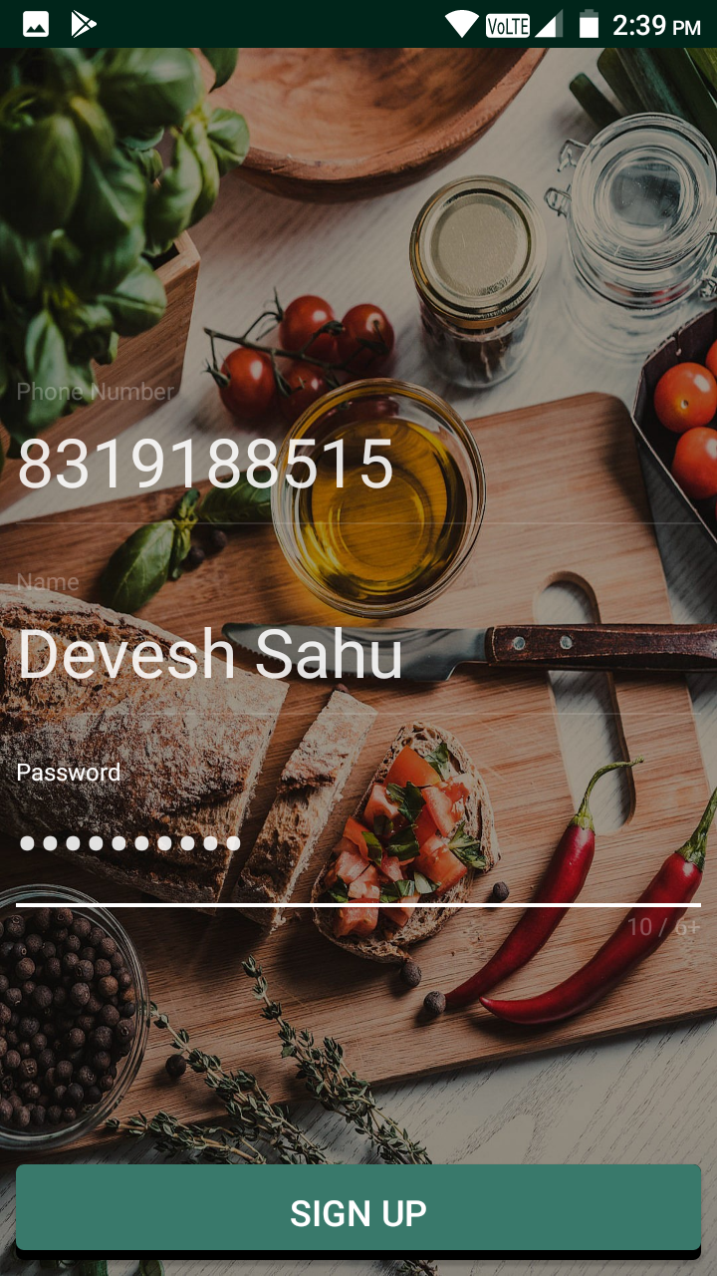
Client APP

Slide 11
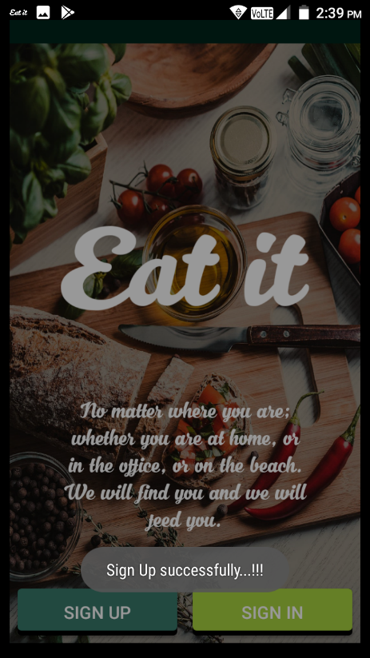
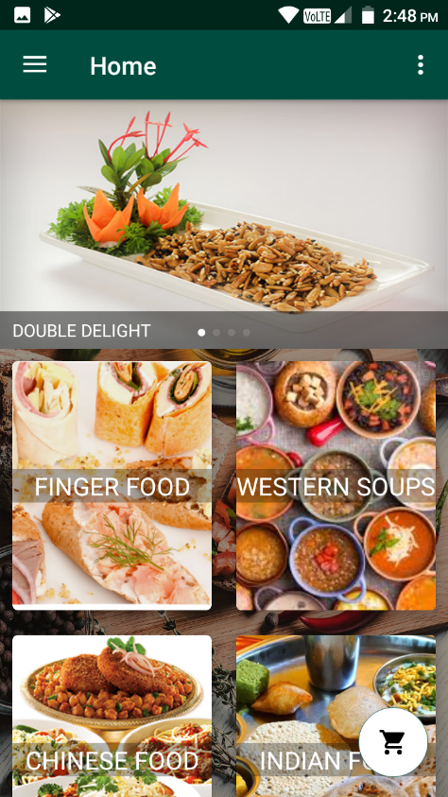
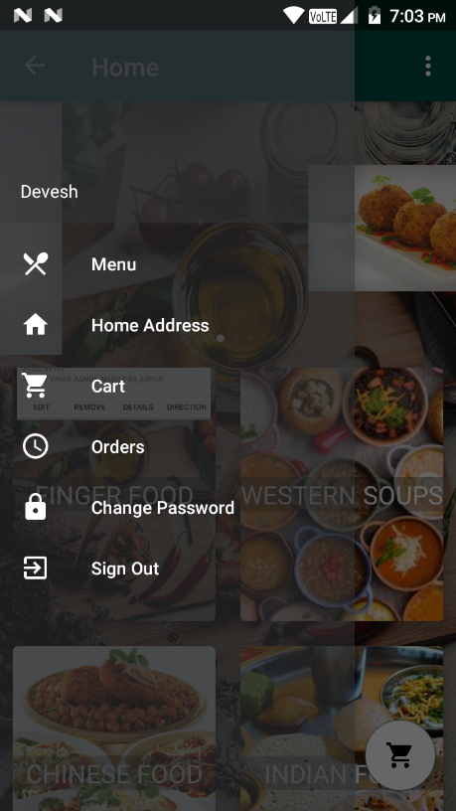
After Successfully Sign Up
Home Activity
Navigation Drawer

Slide 12
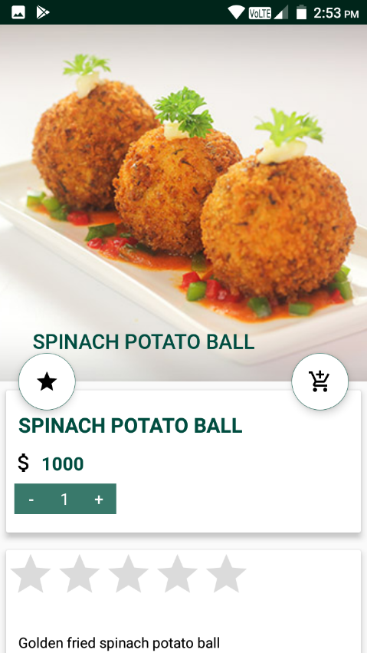
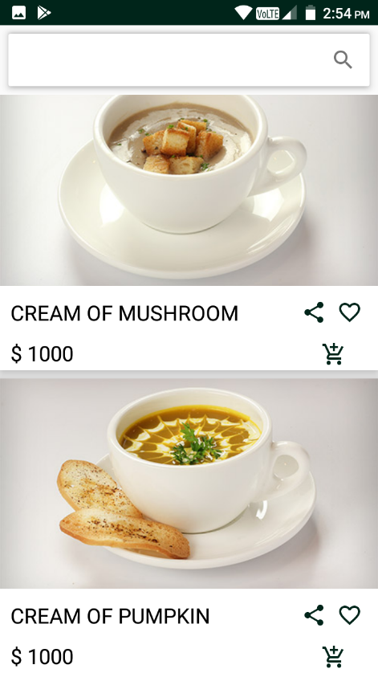
after clicking on Menu
after clicking on banner
from home we clicking on any category then

Slide 13
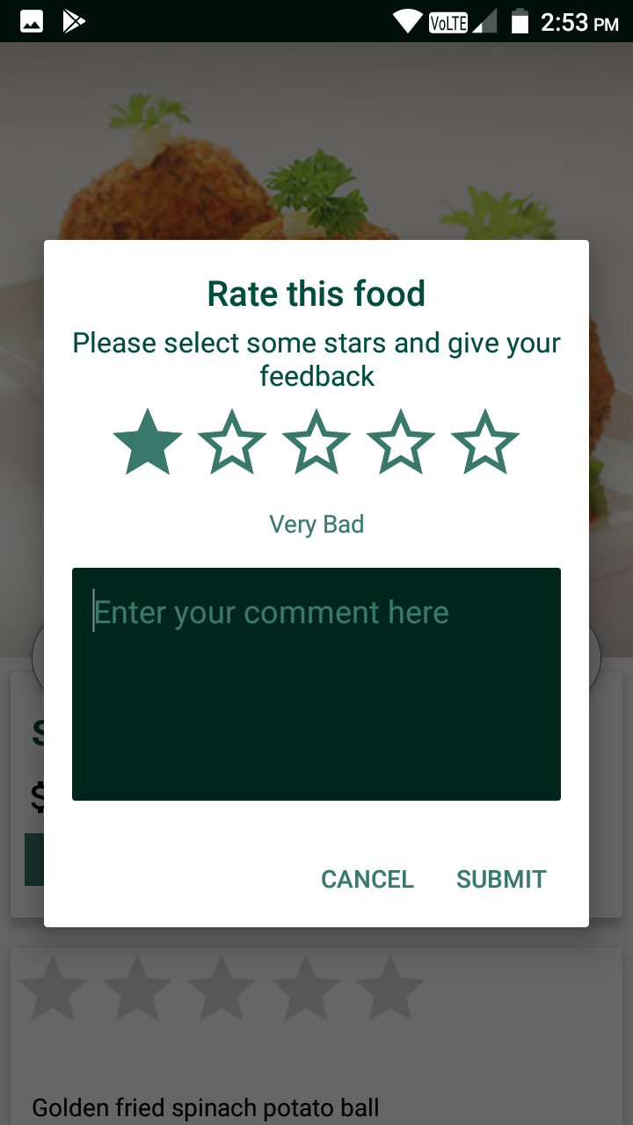
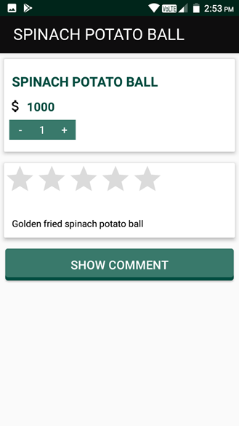
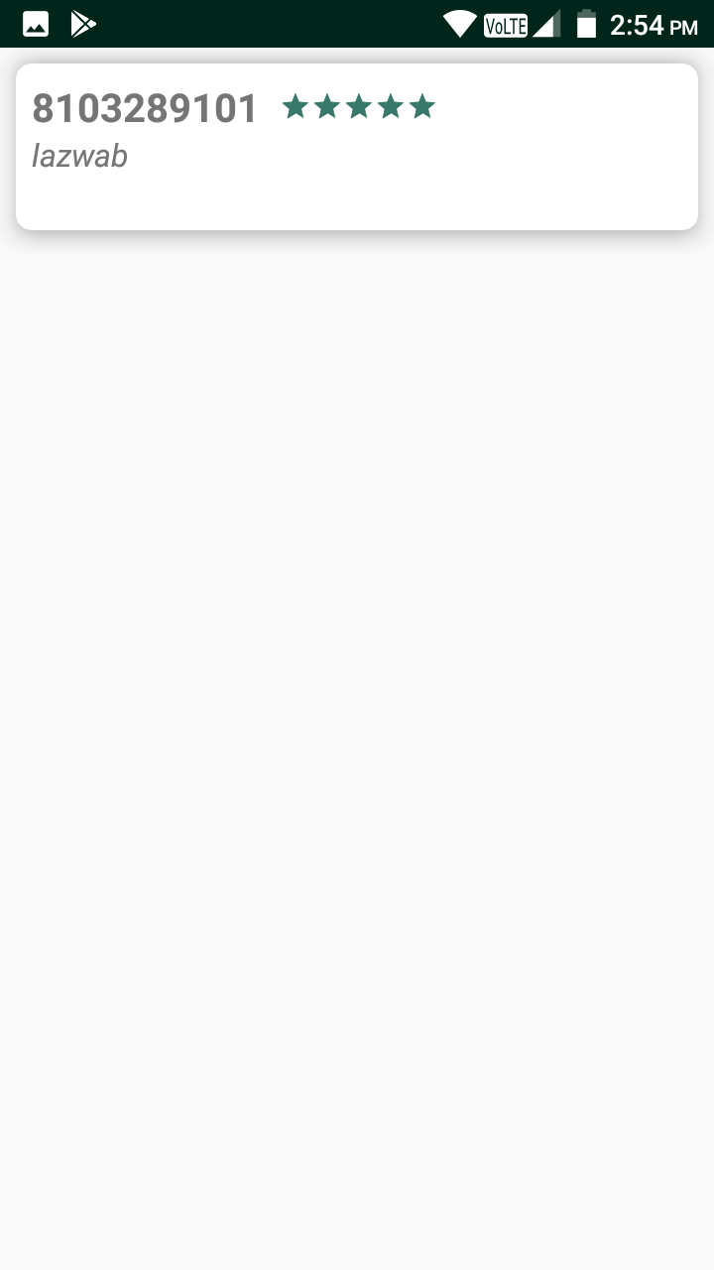
Clicking on star button
On scrolling
click on show comment button

Slide 14
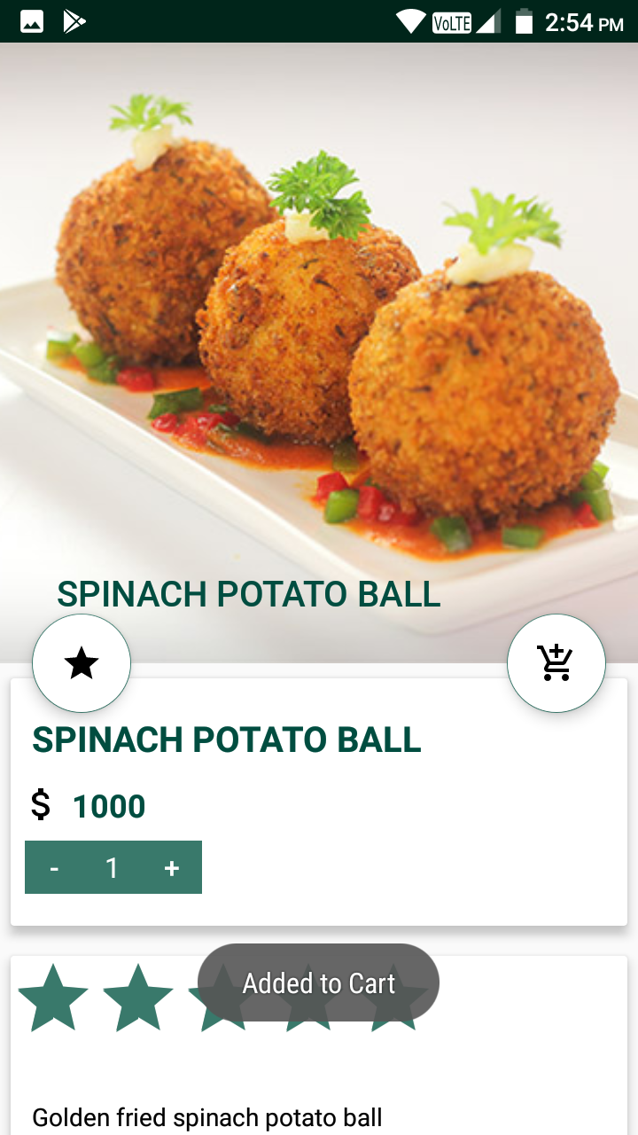
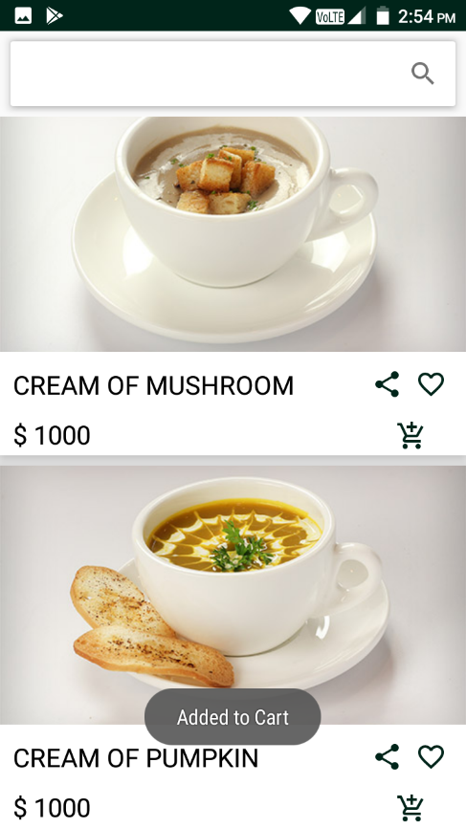
Clicking on cart button
form this we click on any add cart icon then

Slide 15
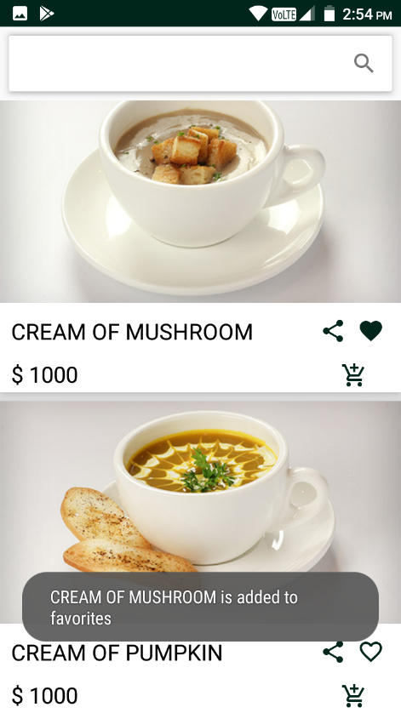
we can add or remove from favorite by click on heart icon shown as below

Slide 16
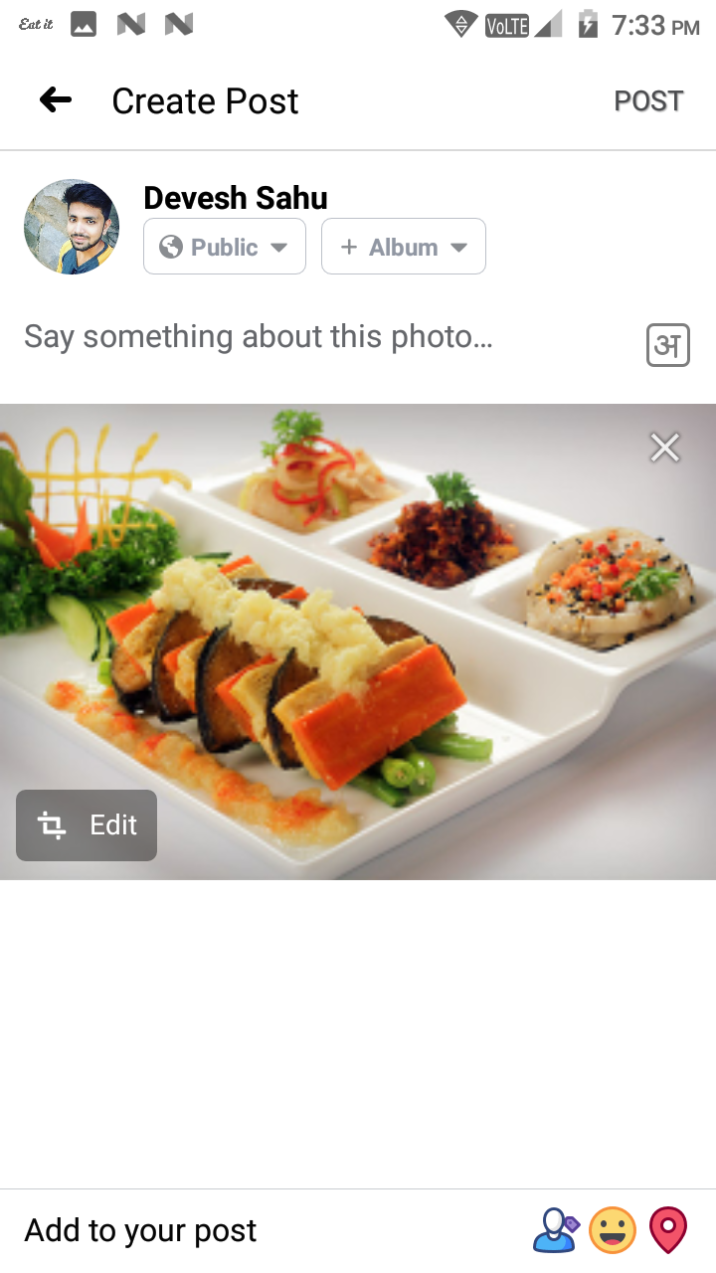
we can share food as post to facebook by clickling on share icon

Slide 17
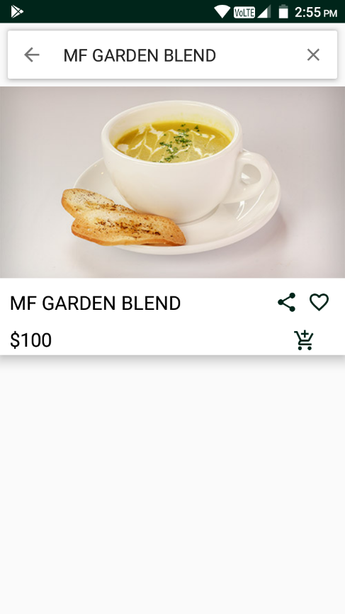
On clicking on Search box & search food successfully

Slide 18
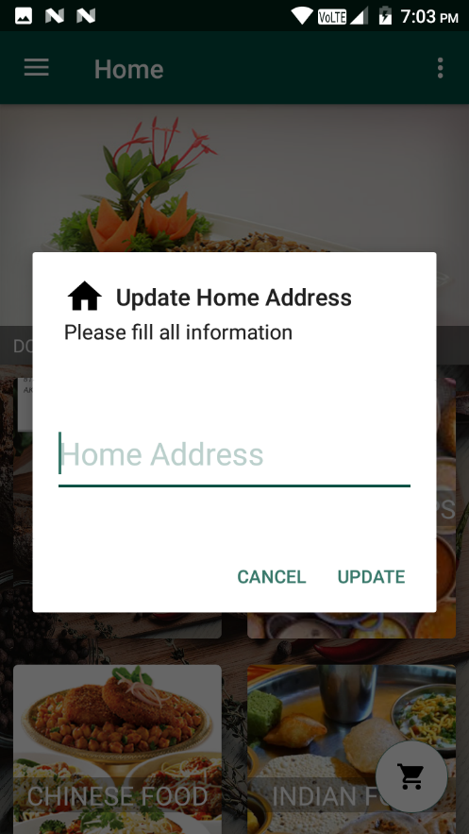
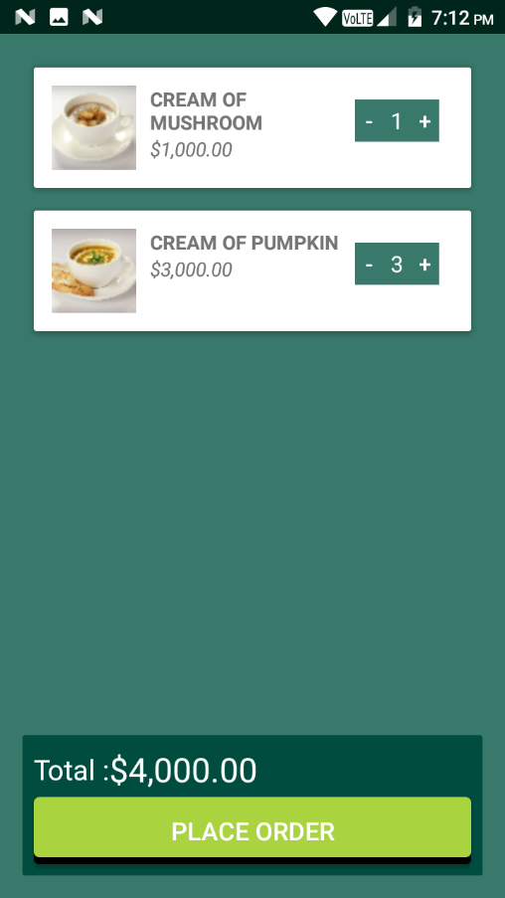

Slide 19
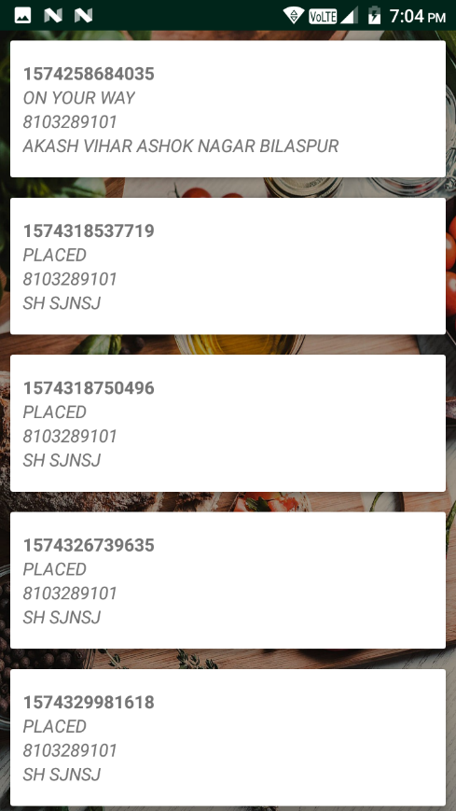
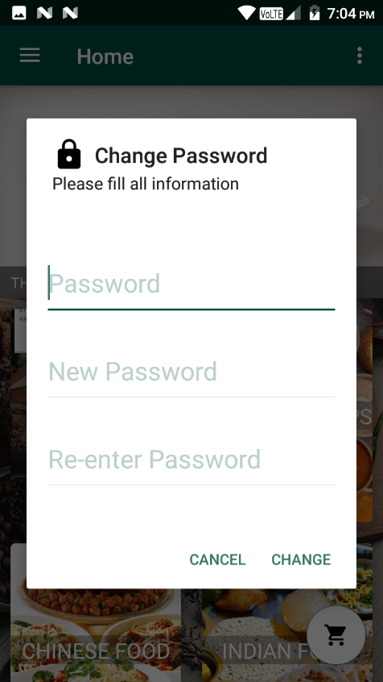

Slide 20
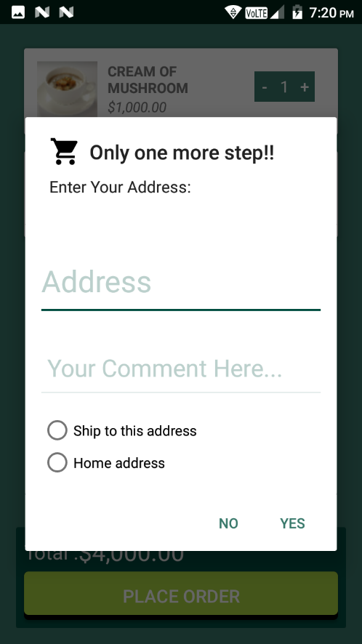
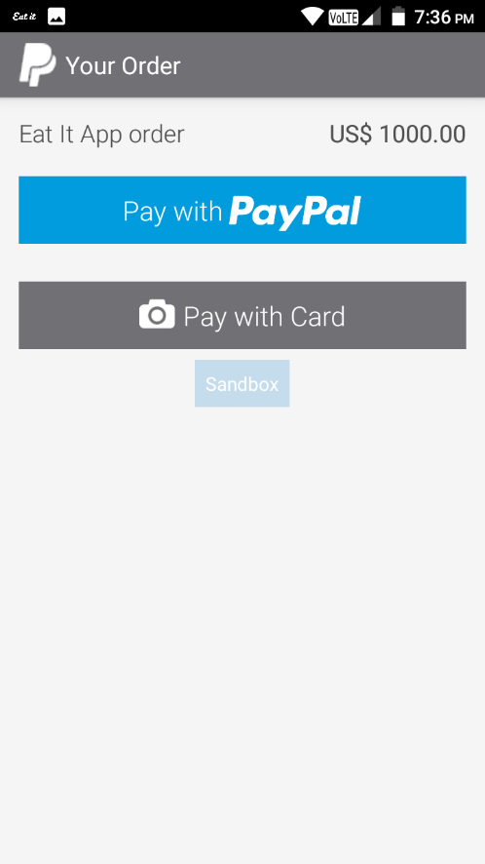

Slide 21
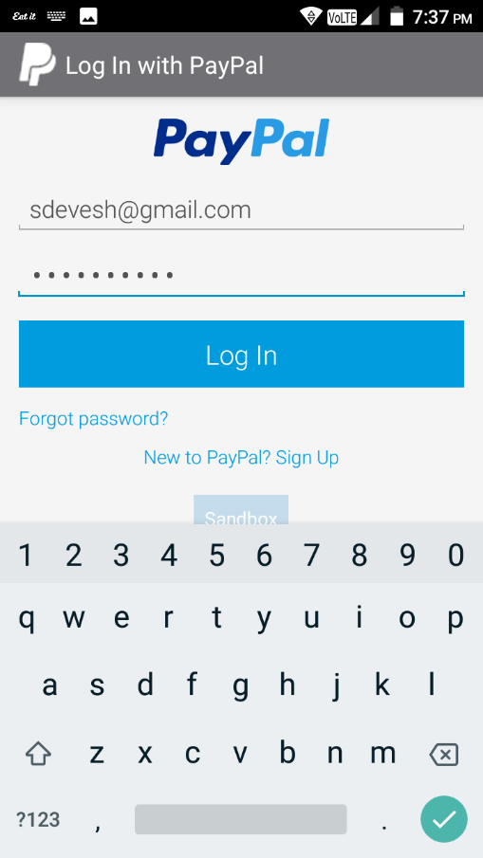
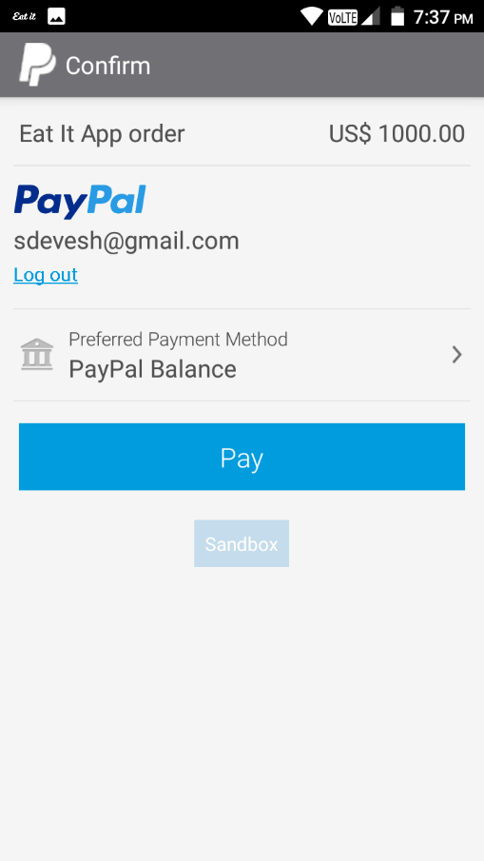
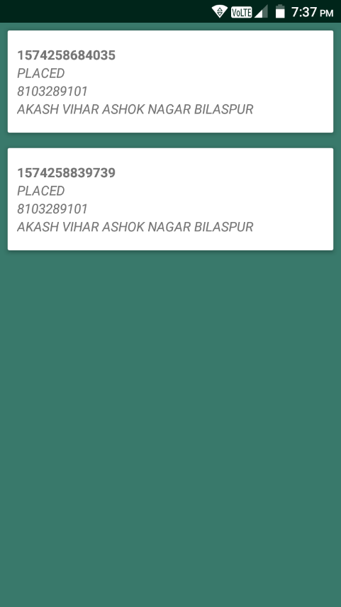

Slide 22
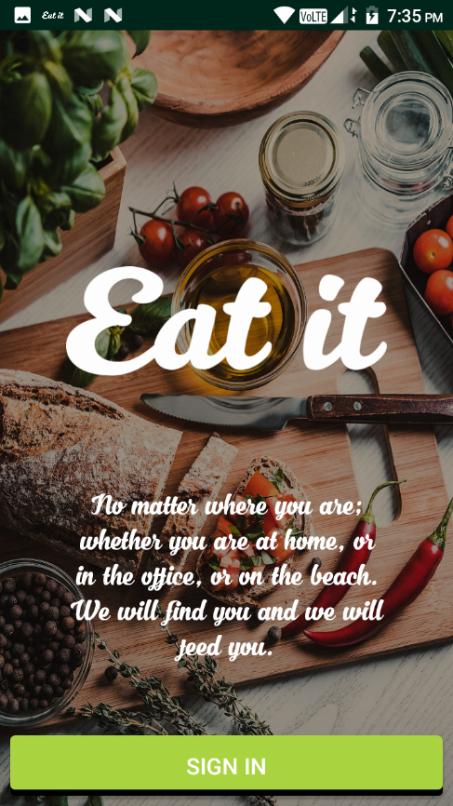
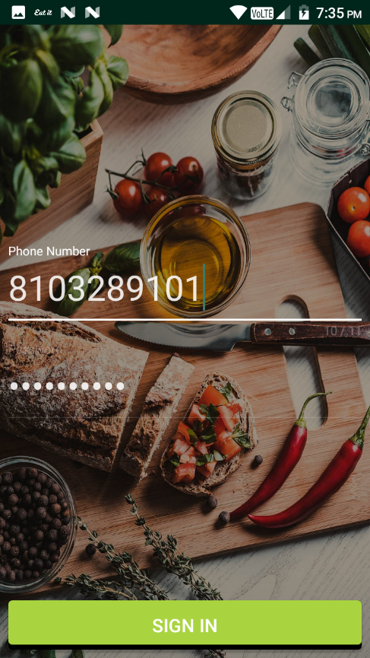
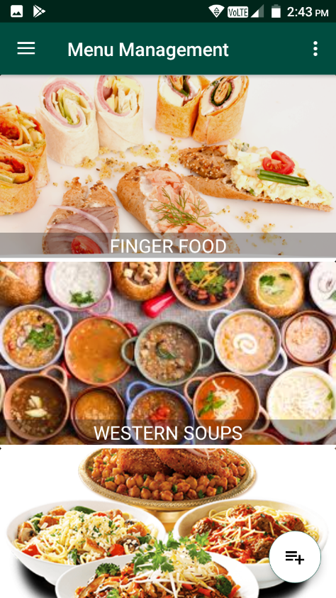
Server or Admin app

Slide 23
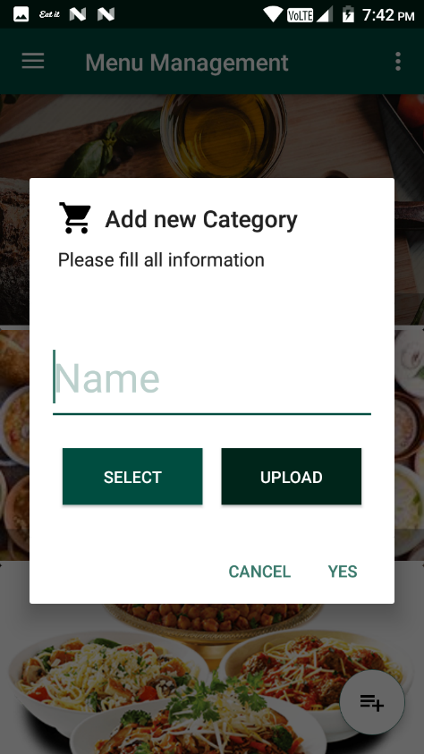

Slide 24
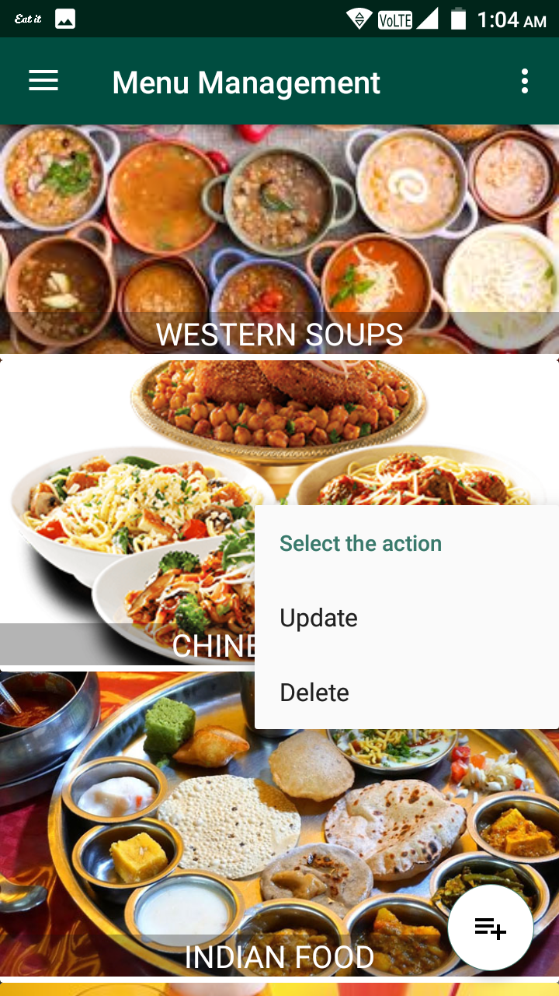
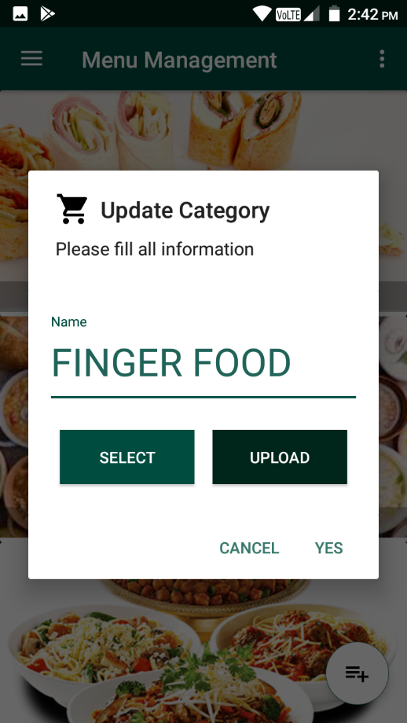
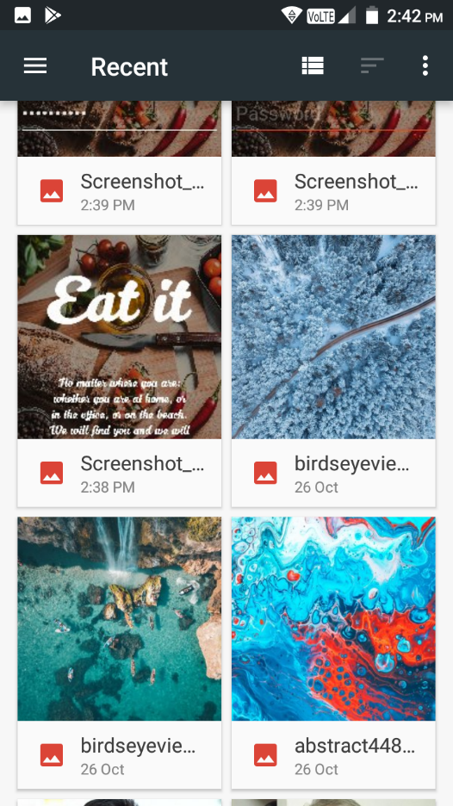

Slide 25
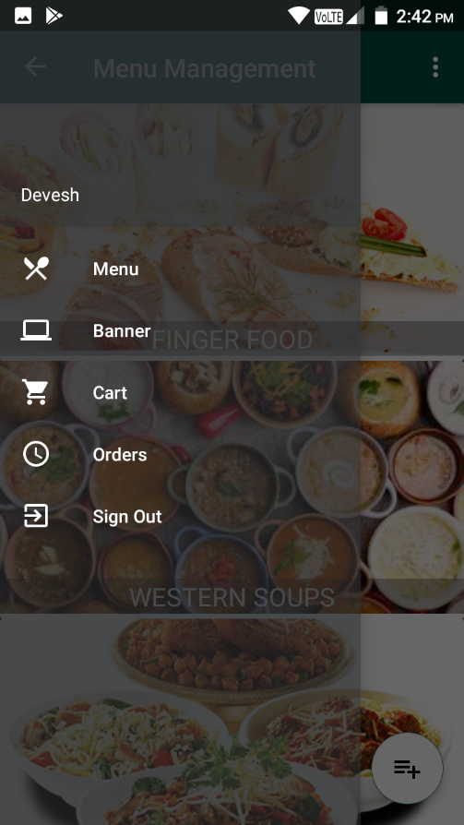
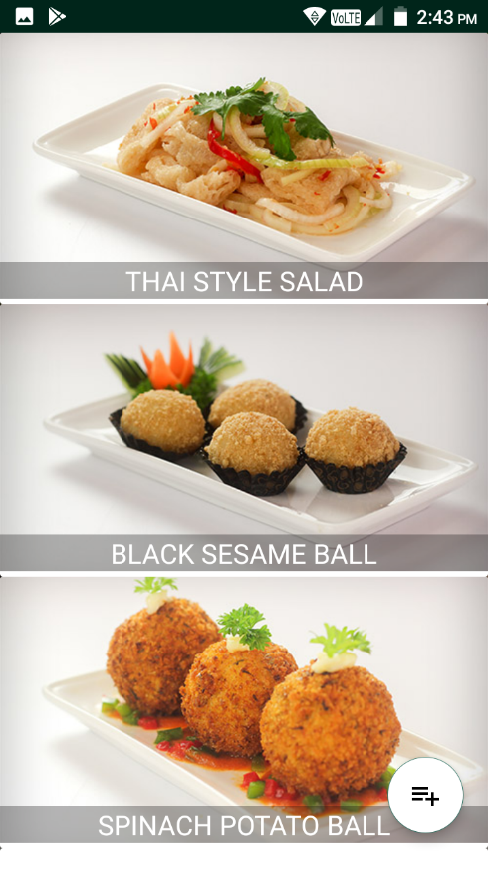
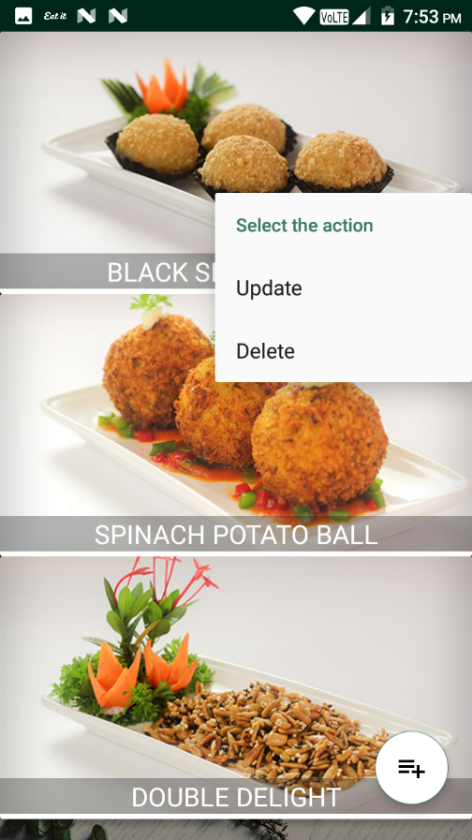

Slide 26
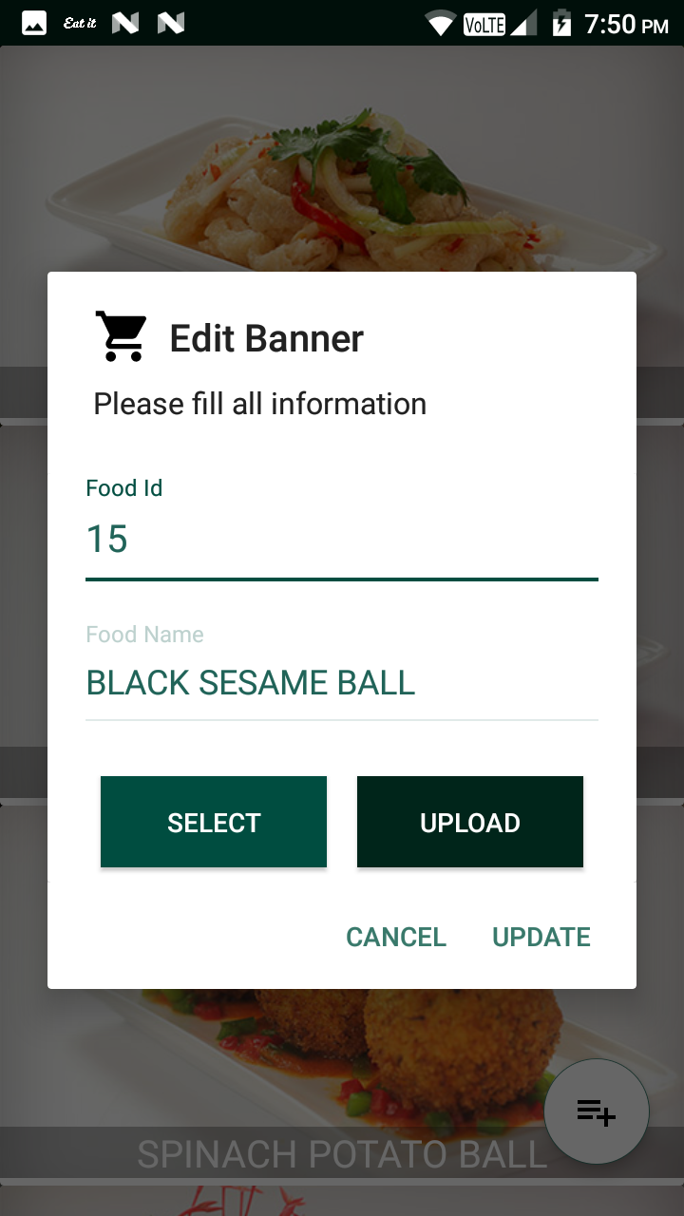

Slide 27
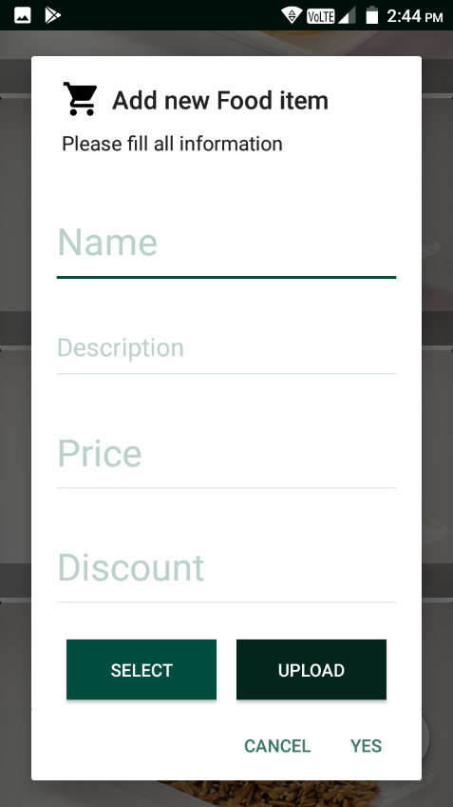
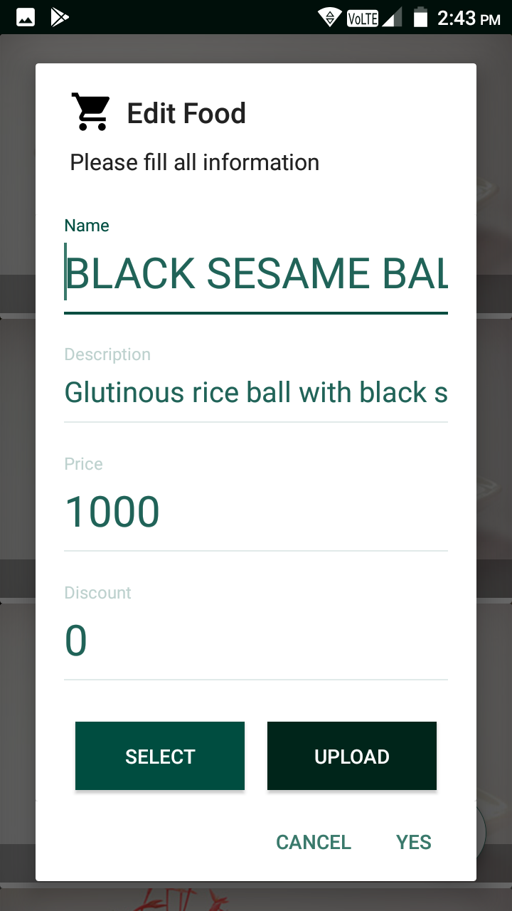

Slide 28
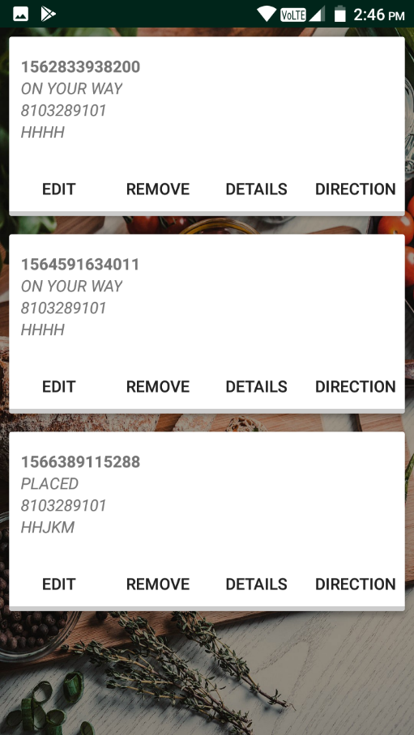
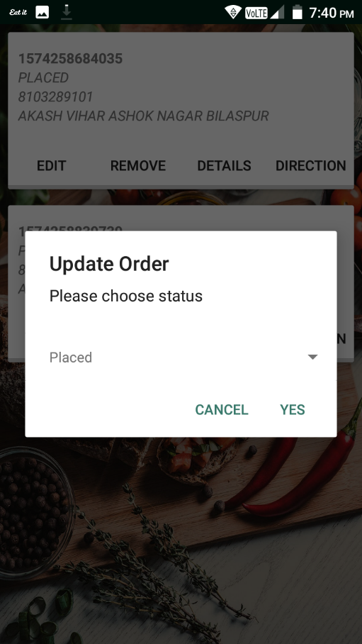

Slide 29
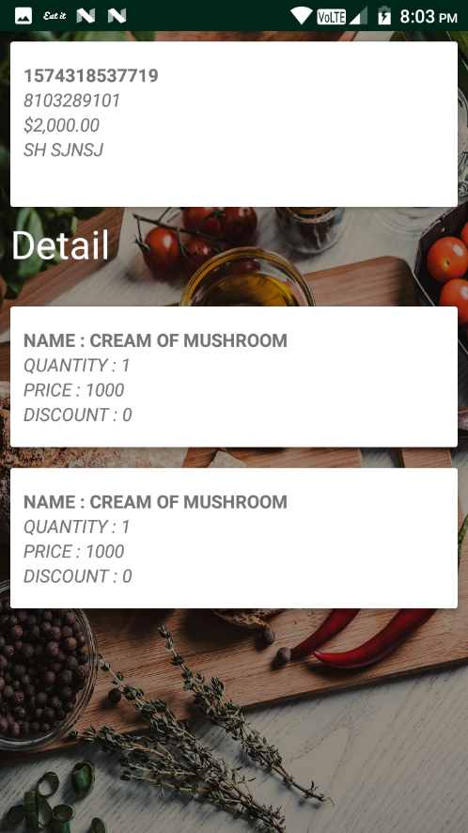
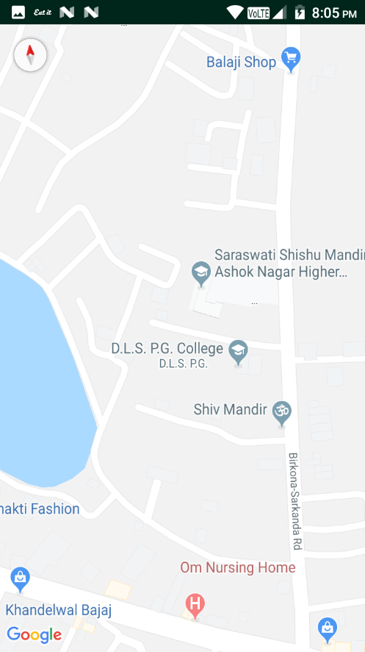

Slide 30
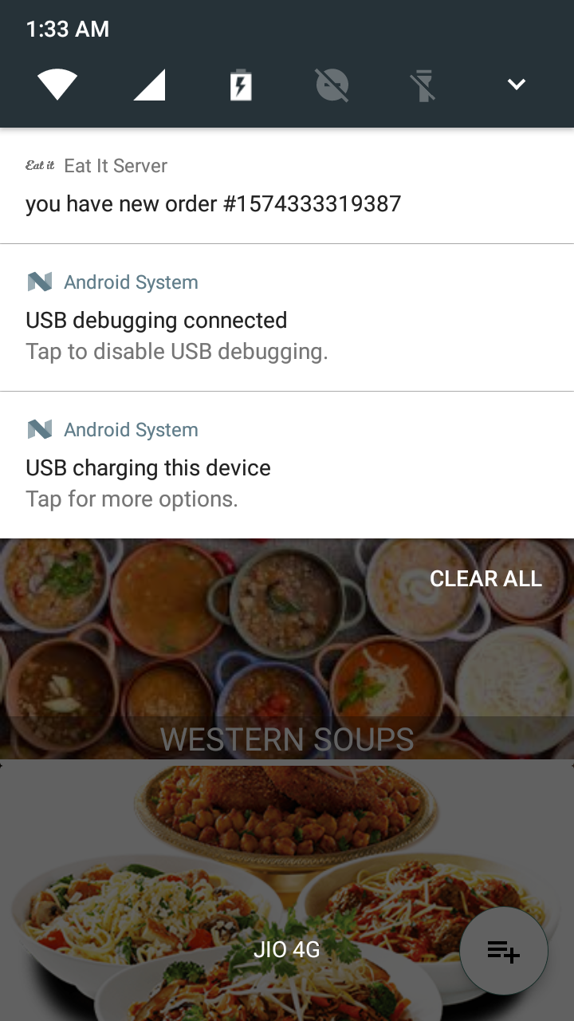
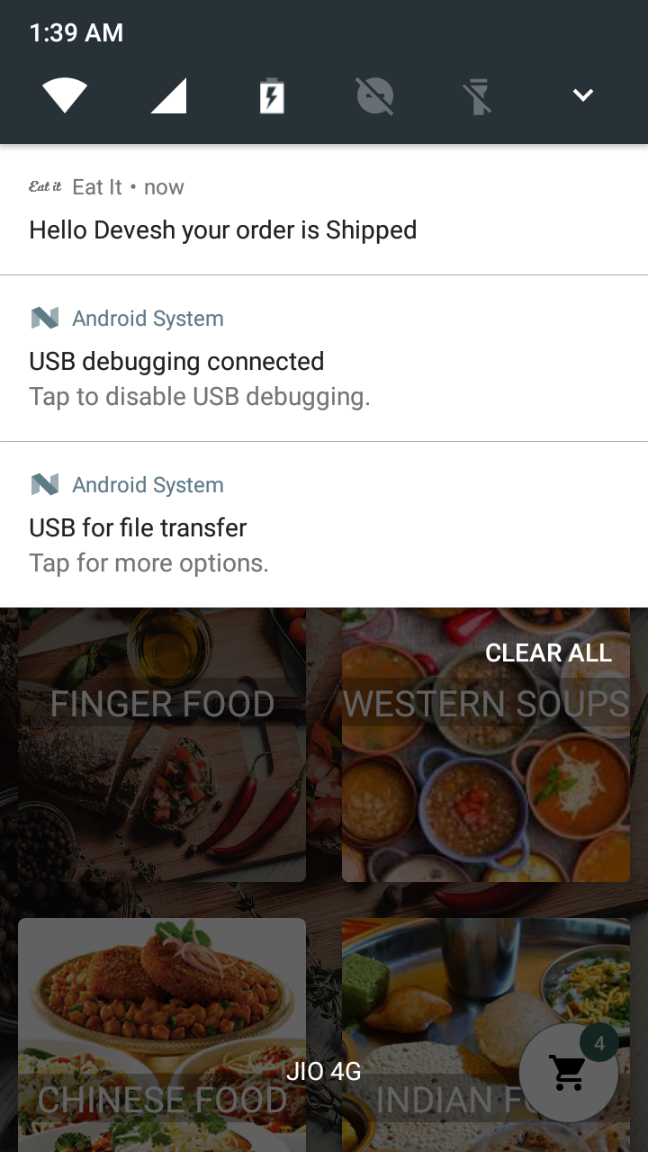
When we get order from client app then server app will got a notification
When we update order from admin or server app then client app will got a notification

Slide 31
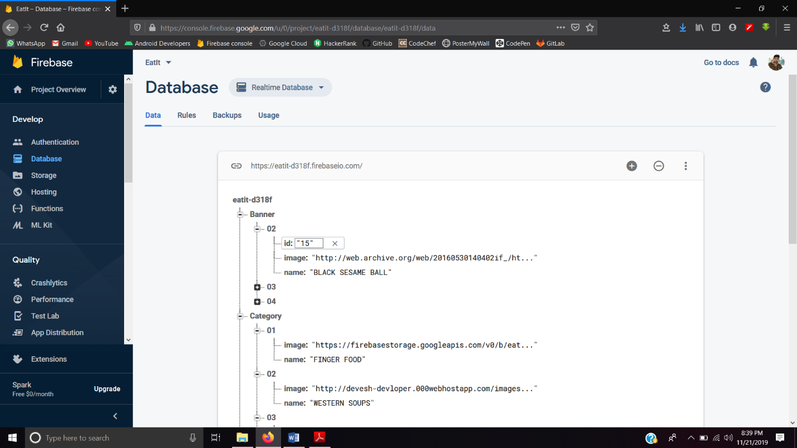
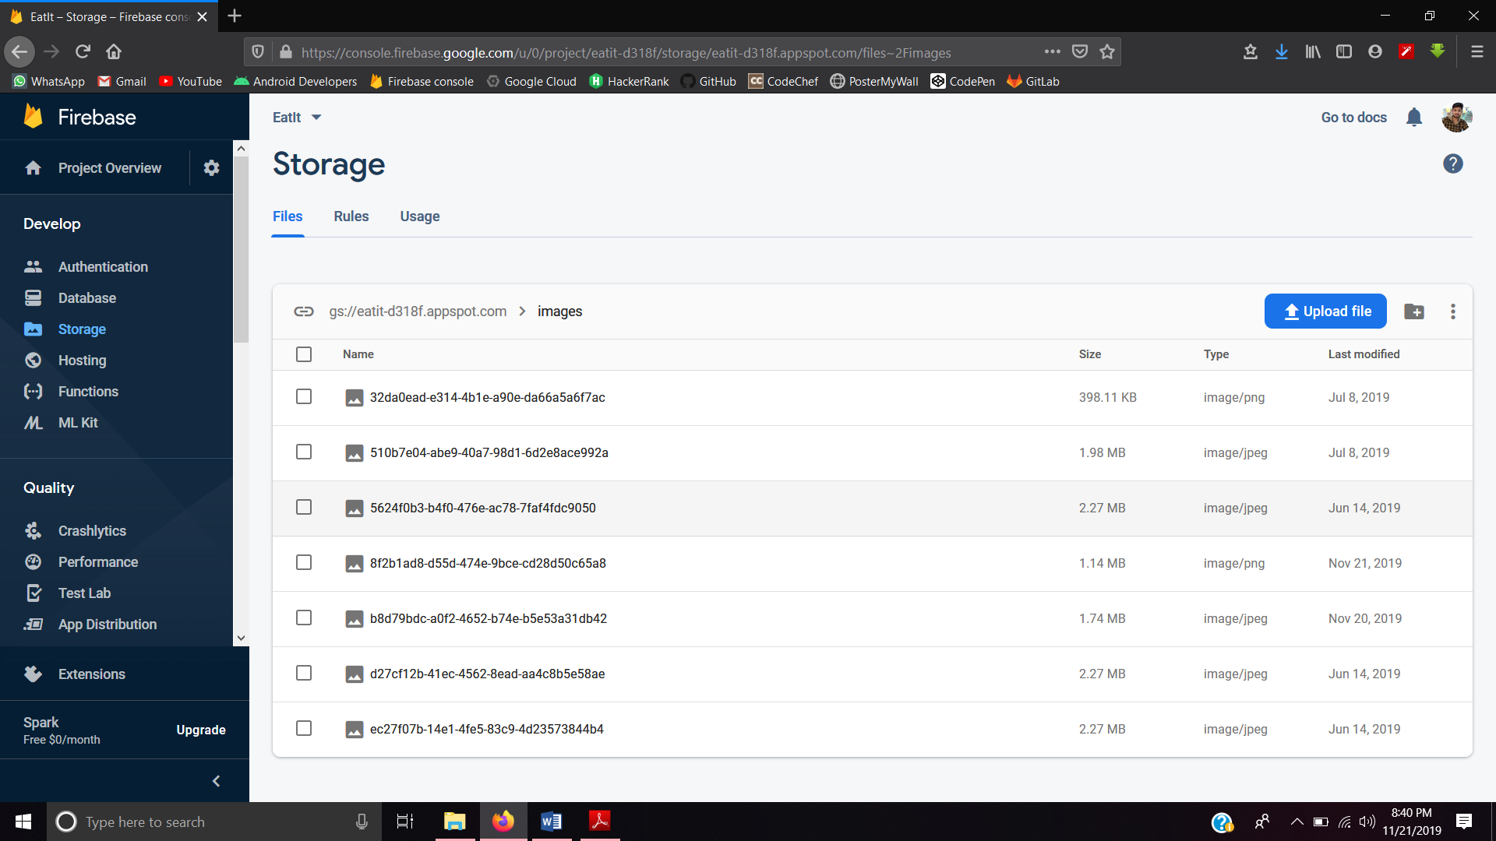
Firebase Realtime database
Firebase Storage

Slide 32
CONCLUSION
In this, we planned the automated food ordering system for the restaurant. The system is compared to earlier food ordering traditional methods such as traditional pen and paper methods etc. We have deliberated advantages of the proposed system over those earlier methods. The segregating factor for the proposed methodology is its adjustable efficiency which comes from the technology it uses.
1. It allow users to browse through different product categories.
2. This is accomplished through an easy to use graphical interface menu options.
3. It allow users to save items to the ordered list and view detailed information about the order.
4. The users can add any number of items to the ordered list from any of the available food categories by simply clicking the Add to Order button for each item. Once an item is added to the ordered list, the user is presented with detailed order to review or continue.
5. It allow the user to Proceed-To-Checkout.
6. It allow the user to track the delivery.
7. This is achieved when a user selects “Proceed to Checkout” button and fill up the Payment material details.
8. It allow the user to see notification message after placing an order.

Slide 33
FUTURE ASPECTS
Increases the habit to use this Application from home to get food just by performing few actions.
Improve the UI & UX.
Live tracking.
Shipper App must be made.
Sometime user don’t get notification fix this issue.
Enhance the security methods.
Normalization of database table to improve database structure & easily retrieval of user data.

Slide 34
REFERENCE
https://developer.android.com/guide
https://www.geeksforgeeks.org
https://www.tutorialspoint.com
https://github.com/
https://console.firebase.google.com/
https://console.cloud.google.com/home/dashboard

Slide 35


